Slide 1
HEX·LOFT
The 3D CMS for Immersive Teams
Manage assets · Curate lofts · Present in AR, VR & Web
Feature Overview
v2026 · Built for Meta Quest, Desktop & Mobile

Slide 2
HEX·LOFT
Feature Deck · 2026
OVERVIEW
A single home for every 3D asset.
Upload, organize, and present 3D models across web, mobile AR, and Meta Quest VR/AR — from one clean, light-themed dashboard.
Content Management
Immersive Viewer
AR / VR Ready
Cloud library of models with metadata, thumbnails, and admin-only access. Persists across devices.
Real-time 3D viewer with orbit, pan, zoom, animations, and physically-based lighting.
One-click hand-off to WebXR on Meta Quest. Room-scale AR with plane and mesh detection.

Slide 3
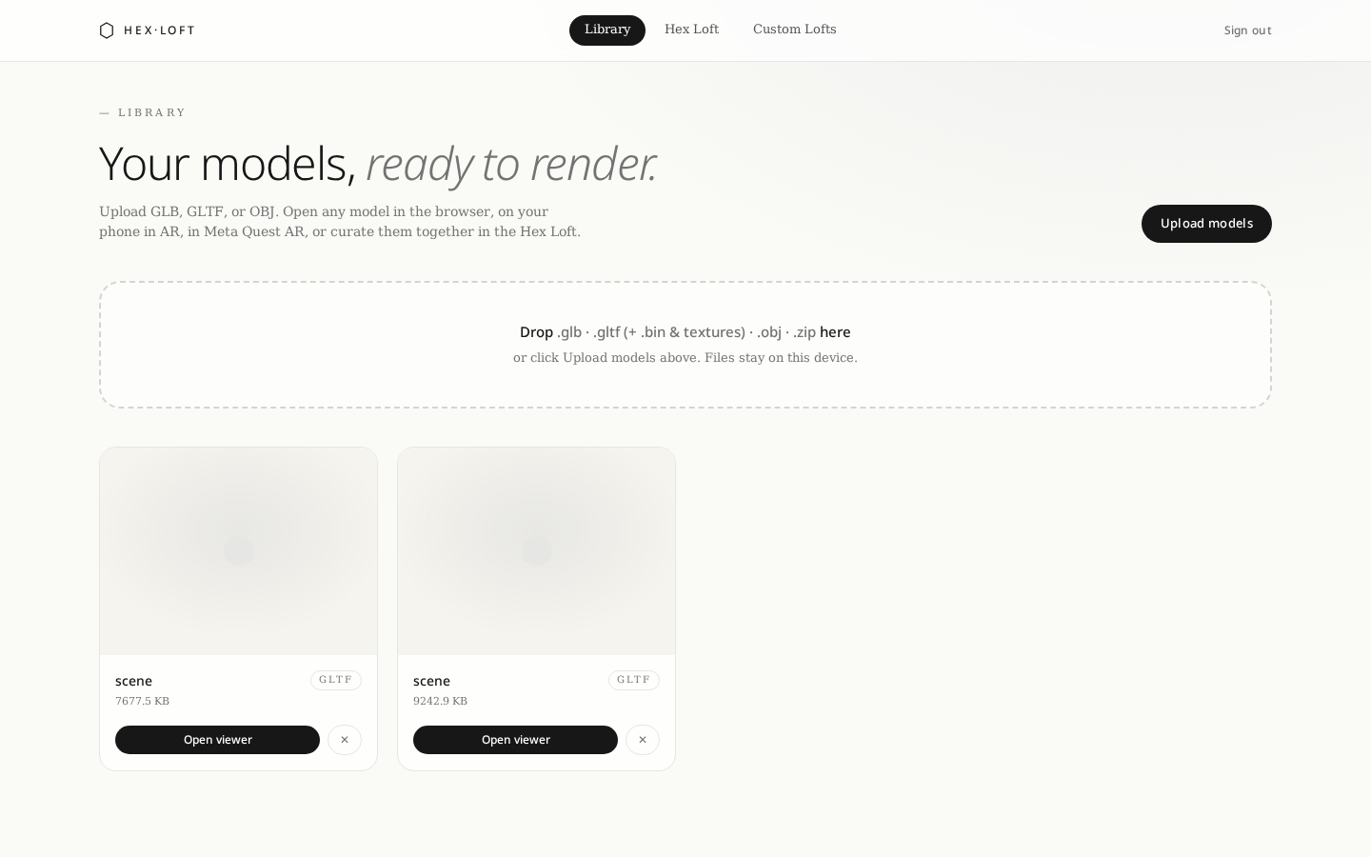
HEX·LOFT
Feature Deck · 2026
LIBRARY
Your asset library, always in reach.
Upload .glb, .gltf, .obj, .fbx, .stl and zipped bundles
Live 3D thumbnails rendered via shared WebGL context
Search, filter, and tag by project or category
Cloud-persisted — same library on every device
Admin-only writes with hardened row-level security

Slide 4
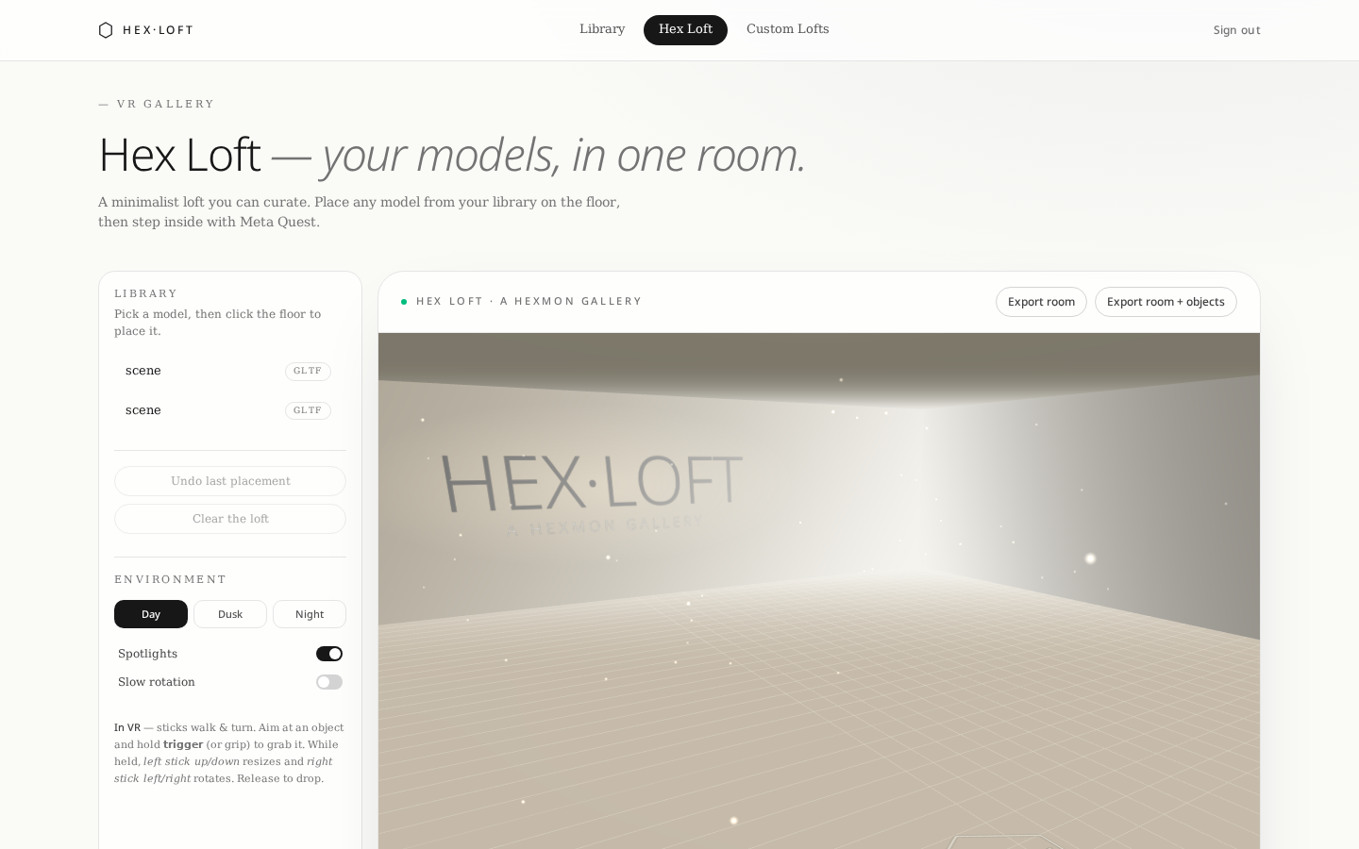
HEX·LOFT
Feature Deck · 2026
HEX·LOFT
A branded VR lobby for your assets.
Glowing HEX·LOFT wordmark and hexagonal pedestals
Day / Dusk / Night loft moods with lighting transitions
Ambient hex-mote particles and idle object bobbing
Place multiple objects from the library into one scene
Animated humanoid avatar with IK arms and walk cycle

Slide 5
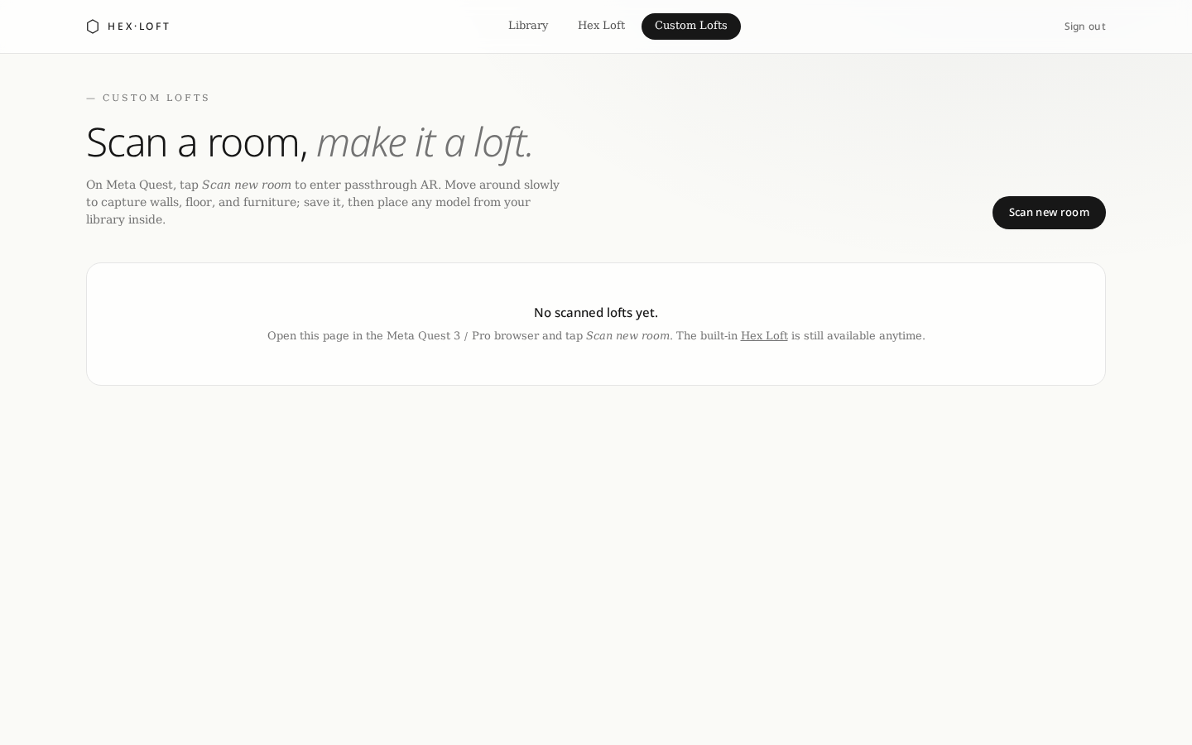
HEX·LOFT
Feature Deck · 2026
CUSTOM LOFTS
Scan the real world into a loft.
Meta Quest mesh & plane detection room scanner
Sweep your head to accumulate geometry with live HUD
Progressive fallbacks: mesh → plane → floor hit-test
Export scans as GLB, saved to your cloud library
Reload any custom loft and drop assets into it

Slide 6
HEX·LOFT
Feature Deck · 2026
VIEWER CONTROLS
Every interaction, mapped.
Desktop
Left-drag: orbit · Right-drag: pan · Scroll: zoom · Double-click: focus
Touch / Phone
One finger: orbit · Two fingers: pinch-zoom & pan · Tap: select
Meta Quest — Controllers
Trigger: grab object · Grip: menu · Left stick: walk · Right stick: smooth turn
Meta Quest — Hands
Pinch: grab & release · Palm-up: HUD · Point: select · Two-hand pinch: scale
Grabbed Object
Move: hand/ray drag · Rotate: right stick X · Scale: left stick Y · Release: trigger up
Animations
Play / Pause · Timeline scrub · Loop toggle · Speed 0.25× – 2×

Slide 7
HEX·LOFT
Feature Deck · 2026
AR · META QUEST
Mixed reality that feels physical.
Room understanding
Auto placement
Plane, mesh, depth & light estimation via WebXR
Objects snap to the detected floor on entry
Hand-tracking
Physical door handle
Pinch to grab, two-hand pinch to resize, point to select
Grab the handle and pull to open, push to close
Button press → tray eject
Contextual ray labels
Top button opens the door and slides the tray out
Arrows and cues appear at the controller ray-tip
Guided walkthrough
Anchors
Multi-step tour with Play / Pause / Next AR HUD
Objects stay locked to real-world positions between sessions

Slide 8
HEX·LOFT
Feature Deck · 2026
VR EXPERIENCE
Walk through your library.
Thumbstick locomotion — left stick to walk, right stick to smooth turn
Animated humanoid avatar mirrors your head and hand movements
Grab, move, rotate and resize any object in real time
Curate multi-object scenes and save layout state per loft
HEX·LOFT branding, hex pedestals and ambient motes
Day / Dusk / Night moods for presentation lighting
Idle bobbing and subtle animation to bring the scene to life

Slide 9
HEX·LOFT
Feature Deck · 2026
ANIMATIONS
Every model, alive.
GLTF animation clips
THREE.AnimationMixer runs embedded clips — including text overlays baked into models
Play / Pause / Loop
HUD controls on desktop, mobile AR and Quest
Rotation controls
Yaw, pitch and free-rotate in AR and VR — both stick and hand-drag
Resize / Scale
Uniform scale via stick, or two-hand pinch in hand-tracking mode
Guided tours
Scripted step-through with pulsing highlights and 3D labels
Idle life
Objects bob gently on their pedestals when untouched

Slide 10
HEX·LOFT
Feature Deck · 2026
FORMATS
Bring anything. It just loads.
.glb
.gltf
.obj
.fbx
.stl
.ply
.dae
.3ds
.usdz
.zip bundles
Sketchfab-style zipped bundles are extracted and stitched in-browser via fflate.

Slide 11
HEX·LOFT
Feature Deck · 2026
ENTERPRISE
Deploy anywhere. Even offline.
Air-gapped ready
3D scanner ingest
Admin auth
Runs fully offline for secure sites and industrial floors
Direct connection to structured-light and photogrammetry rigs
Single-account admin gate with hardened RLS on all writes
Cloud persistence
Cross-platform
Zero install
Assets, lofts and scans stored in Lovable Cloud storage
Desktop, iOS/Android AR, Meta Quest VR & AR from one URL
WebXR — no app store, no APK, no side-loading

Slide 12
HEX·LOFT
Feature Deck · 2026
WORKFLOW
From upload to walkthrough in minutes.
01
→
02
→
03
→
04
→
05
Upload
Preview
Curate a Loft
Enter AR / VR
Present
Same asset. Same URL. Every surface — laptop, phone, Quest.

Slide 13
HEX·LOFT
Ready when you are.
Sign in as admin and start curating your first loft.
hexloft.app · Built for Meta Quest, Web & Mobile

